Slide 1
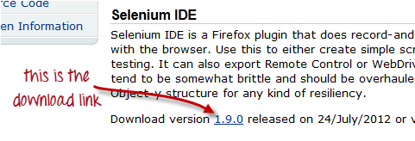
Installing Selenium IDE
Step 1: Go to http://seleniumhq.org/download/. Under the Selenium IDE section, click on the link that shows the current version number.
For security, a Firefox notification will pop up. Click on "Allow."

Slide 2
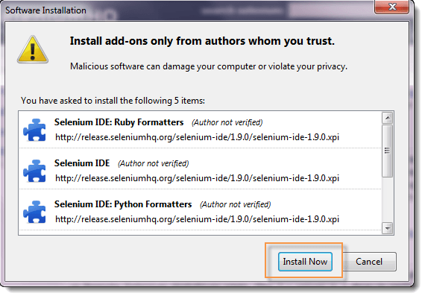
Step 2: Wait until Firefox completes the download and then click "Install Now."
Wait until the installation is completed. In the pop-up window, click "Restart Now."

Slide 3
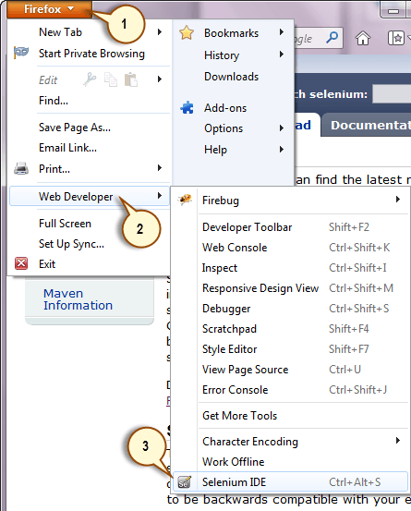
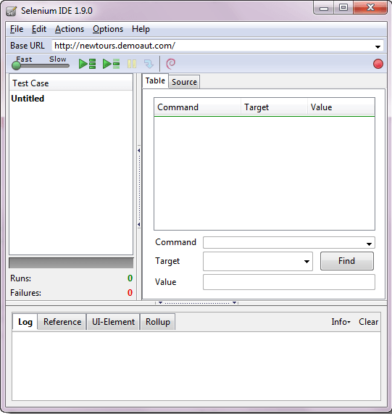
Step3 : After Firefox has restarted, launch Selenium IDE using either of two ways:
By pressing Ctrl+Alt+S
By clicking on the Firefox menu button > Web Developer> Selenium IDE

Slide 4
http://adam.goucher.ca/parkcalc/

